Slide 1
Temperature Logger
Marton Lorinczi
2017.06.09

Slide 2
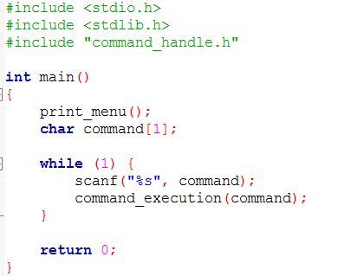
Most complex code you have ever seen !

Slide 3
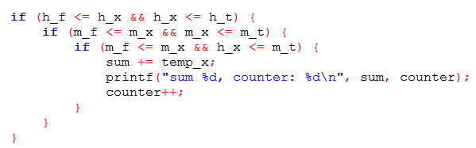
This line was half day of work →
Too much variable for a little work →
How many conditions are here? →

Slide 4
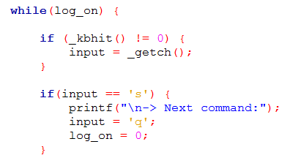

How to intterupt in a while?

